Slide 1

MBC
2021 Jan| TSC Nanjing

Slide 2
Dynamic Areas
File Preprocessing
The purpose is to make a file readable.
This is necessary to fetch references and to do a content detection if necessary.
Possible action could be an uncompressing or an encryption.
CR_StoreMessageToDisk, CR_CallXibMBC, CR_ExchangeString, CR_RemoveRecord, CR_ConvertRef, CR_SubHandler
Content Detect
Under Manage Rule it is possible to choose in this area an MBC which does a content detection.
CR_ContentDetectStandard, CR_ContentDetectStandardAndXML
PreProcessing
In case that an Axway Inbound Process should be used it is necessary to feed this Process with correct EDIFACT or ANSI X12 files. If data will be received with line feeds it is necessary to delete them before. This should be done in this area. Because the Inbound Processes define also which message will be enveloped together it can be necessary to group them before the inbound Process in the right way. Some example MBC for these areas are EDI and ANSI X12 split programs, CR_ExchangeString (to remove line feeds). In case that the Inbound Process area will not be used, you can do this preprocessing in the Dynamic Process area.
CR_AnsiX12Split, CR_EdiSplit, CR_ExchangeString

Slide 3
Dynamic Areas
Inbound Process
Here you define if you want to use one of the Standard Axway Inbound processes for EDI Version 3, EDI Version 4 or ANSI X12 messages. It is also possible to create an own MBC which does an Inbound process e.g. CR_InhouseInbound splits standard In-house Files into messages and set the grouper attribute to envelope the messages at the end in the right sequence.
InboundX12 , InboundEDI3, CR_InhouseInbound
Inbound Map
To do a validation in the Inbound Process for EDI or ANSI X12 messages a one to one map is necessary. This has to be called in this area.
Dynamic Processing
In this area you should process the messages. This includes all maps but also copy or split programs or other processing of the data.
Outbound Process
If you want to envelope data you can use this Outbound process. There are the standard Axway Enveloper available for EDI Version 3, EDI Version 4 and ANSI X12 and it is also possible to create own MBCs which can be called dynamically as CR_InhEnvCreateMessage
EnvelopeEDI3, EnvelopeX12

Slide 4
Dynamic Areas
Postprocessing
After the Outbound Process it might be necessary to change the structure of the file. E.g. the customer likes to receive EDIFACT data with Linefeeds after each Segment or after a number of characters.
CR_ExchangeString, CR_CutToLineLength

Slide 5
Edit
CR_RemoveString
Removes all occurrenceies of a specified character from the message
CR_ExchangeString
Exchange Strings
CR_AddHeaderFooter
This MBC adds a header and/or footer string to the message.
CR_CutToLineLength
Cut lines to defined line length
CR_EditRecord
Edit a fixed or configurable record inside a message

Slide 6
Edit
CR_RemoveLineFeed
Removes all line feeds from a message and sets line feed at end of message if configured.
CR_RemoveRecord
removes records from the message
CR_AddRec_v2
Add a fixed or configurable New Record to the message after the standard headers.

Slide 7
Copy
CR_CopyToRoutingCodes
Create copies of the Message and sends they to the specified routing codes
CR_CopyMsg
Uses Condition Table to route copies of messages to separate routing codes

Slide 8
Inbound
InboundEDI3
Standard Inbound process for EDIFACT version 3
InboundEDI3FG
Standard Inbound process for EDIFACT version 3 with Functional Groups
InboundEDI4
Standard Inbound process for EDIFACT version 4
InboundEDI4FG
Standard Inbound process for EDIFACT version 4 with Functional Groups
InboundX12
Standard Inbound process for ANSI X12
CR_InhouseInbound
The CR_InhouseInbound splits all business documents in a message.

Slide 9
Split
CR_AnsiX12Split
Splits and regroups AnsiX12 messages that can be forwarded or stored to disk
CR_EdiSplit
Splits and regroups Edifact messages that can be forwarded or stored to disk
CR_InhouseSplit
Splits and regroups Inhousemessages
CR_MsgSplit
creates a new message with header and trailer for every configured record
CR_XMLSplit
Splits and regroups XMLmessages
CR_SplitByContentType
Splits by message content type

Slide 10
Outbound
EnvelopeEDI3
Envelope EDIFACT Version 3 including definition of Envelope Attributes
EnvelopeEDI4
Envelope EDIFACT Version 4 including definition of Envelope Attributes
EnvelopeX12
Envelope ANSI X12 including definition of Envelope Attributes

Slide 11
Miscellaneous
CR_ConvertRef
Converts Reference Values
CR_CallXibMBC
Calls Axway XIB programs
CR_SetPassOnFlag
Sets the PassOn-flag, so that no further process-step is executed
CR_SubHandler
External program/script call
CR_Wait
The CR_Wait waits the configured time (s).

Slide 12
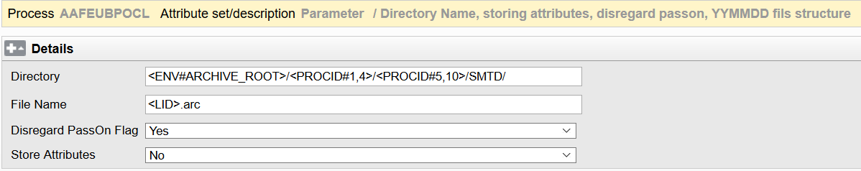
CR_StoreMessageToDisk
Directory: A suffix of format YYYY/MM/DD/ will be added to the "Directory" parameter before the filename is added.
<ENV#ARCHIVE_ROOT>:
Last 2 days: /app/sword/schenker/archive
Long term archive: /archive
Disregard PassOn Flag: Will store the message even if the Pass on flag has been set before by another MBC.
Store Attributes: Will store an attribute file into the same directory along with the message. The attribute file will be stored with the same filename used for the message extended by .att

Slide 13
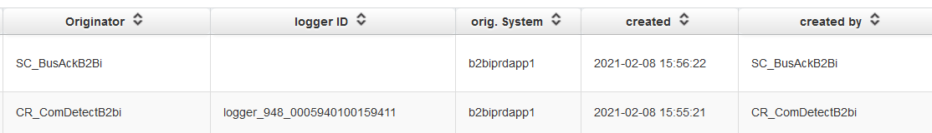
CR_StoreMessageToDisk
Bracket code <LID> returns the LoggerID when message was detected. If you need the LoggerID at runtime of CR_StoreMessageToDisk please use Bracket code <LID_LATE>.

Slide 14
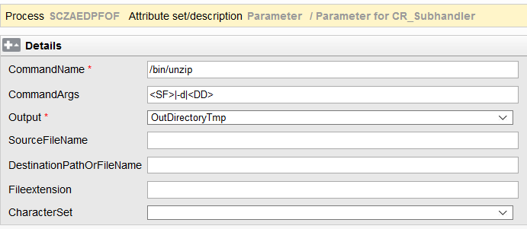
CR_Subhandler

Slide 15
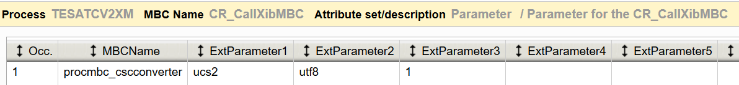
CR_CallXibMBC
Convert encoding from UCS-2 to UTF-8
procmbc_cscconverter
Most used encodings:
utf8
iso8859:2
iso8859:2
windows:1250

Slide 16
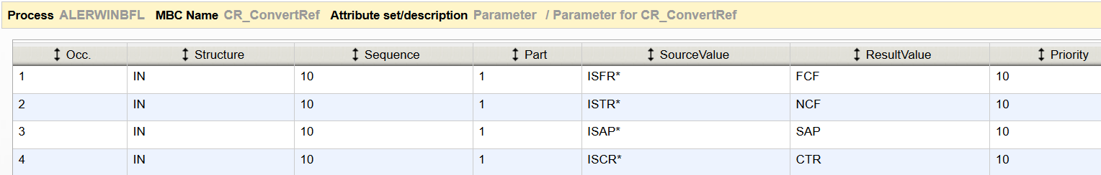
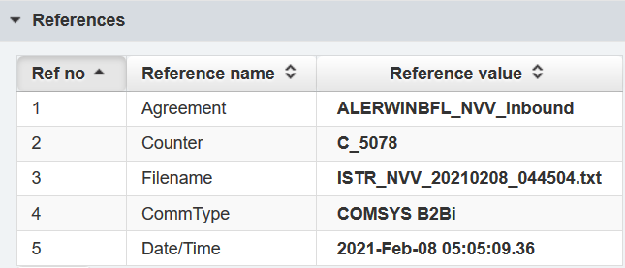
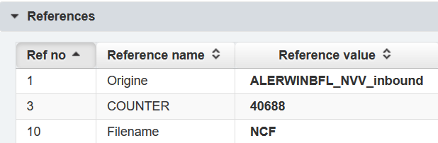
CR_ConvertRef
The MBC is only a dummy for specifying the attribute set that is processed in CR_FetchRef.
in the FilePreprocessing stage
If you want to evaluate a complete multipart reference you can set the part number to 0.
CR_ConvertRef must be configured only once per Process ID.

Slide 17
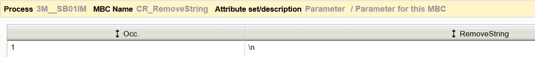
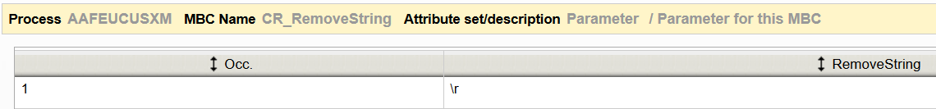
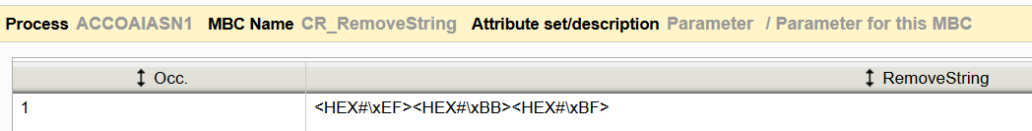
CR_RemoveString
Remove linefeed
Remove BOM

Slide 18
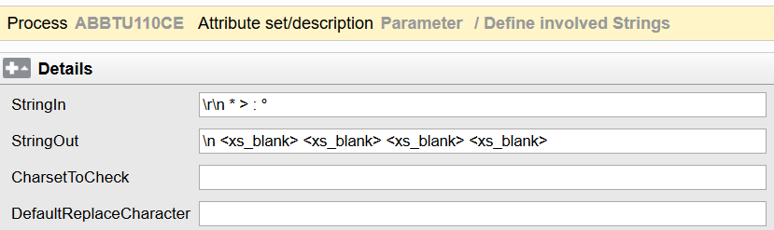
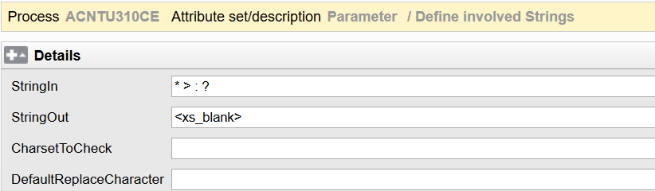
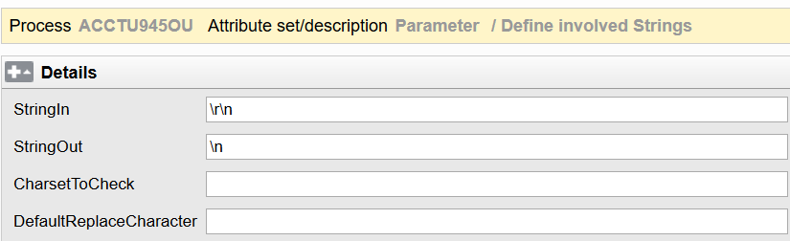
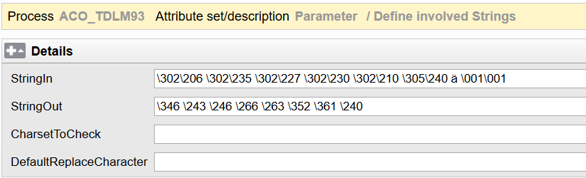
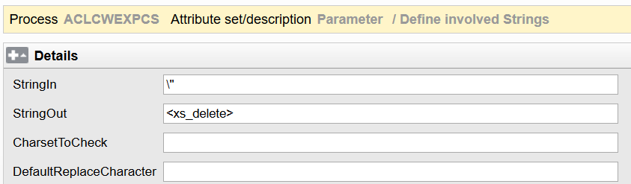
CR_ExchangeString
Change CRLF to LF
Oct
Remove \"

Slide 19
CR_AddHeaderFooter
Header: String that will be placed right in front of the original message, followed by delimiter.
Footer: String that will be placed after delimiter of original message.
Delimiter: If string is empty, “NL”, “LF” or “\\n”, the delimiter will be interpreted as a newline character. In other cases, the string value is used as separator between Header and Message and Message and Footer. Default add LF at the end of file.
Add Header, can use bracketcode
Add xml header, footer
Add linefeed

Slide 20
CR_AddHeaderFooter
Add UNA header
Add A0Q, A1Q header
Add xml header
Add csv header

Slide 21
CR_CutToLineLength
Cut a single line file into slices of a defined length (default is 80). If that single line is shorter than the defined length, it will be padded with blanks.
Set the line length of a multiple line file to the defined length. If the length is shorter, it will be padded with blanks. If its longer, it will be cut and the rest of the line will be put into the next line.
LineLength: the length of the rows of the output file. If the line length is set to "0", the program will set it to "80"

Slide 22
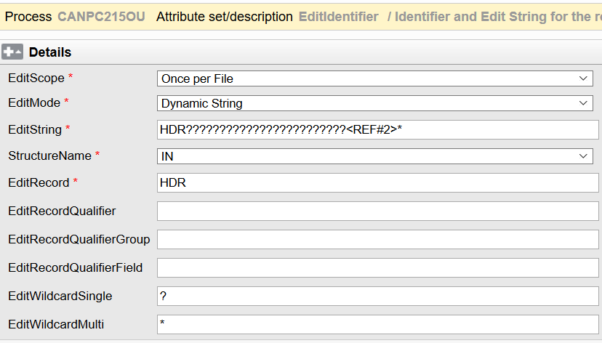
CR_EditRecord
<REF#2>: 0053225
Once per File: will replace the 1st occurrence

Slide 23
CR_RemoveLineFeed
Default remove LF

Slide 24
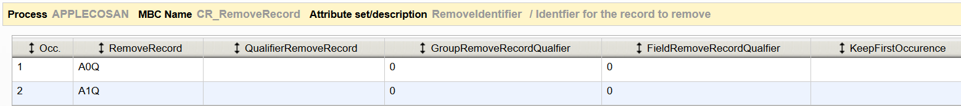
CR_RemoveRecord
RemoveIdentifier
Parameter
Listtype | Checkbox - White / Black list (default unchecked = blacklist --> remove configured records; white list --> only keep conf. records
ForwardEmptyMsg | Checkbox Yes/No - (default unchecked = No --> set PassOn in case of empty message; Yes --> forward empty message)
RoutingCode | Optional new RoutingCode for empty message

Slide 25
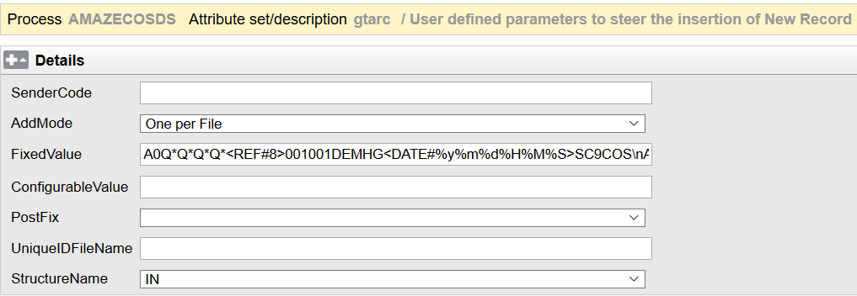
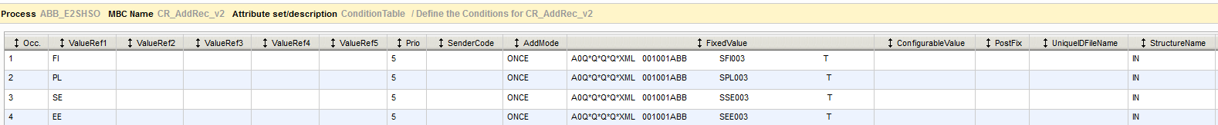
CR_AddRec_v2
Add accordingly

Slide 26
CR_AddRec_v2
ConfigurableValue

Slide 27
CR_CopyToRoutingCodes
Note: Routing code in general page must be configured

Slide 28
CR_CopyMsg
Do not use NOT_SENT in combination with CR_CopyMsg

Slide 29
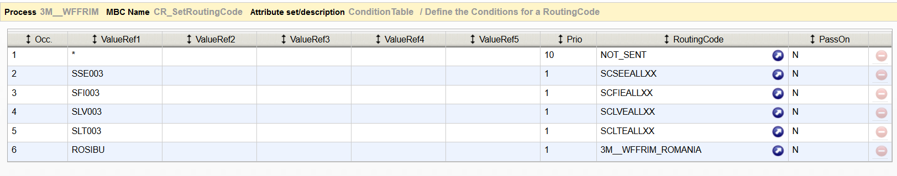
CR_SetRoutingCode

Slide 30
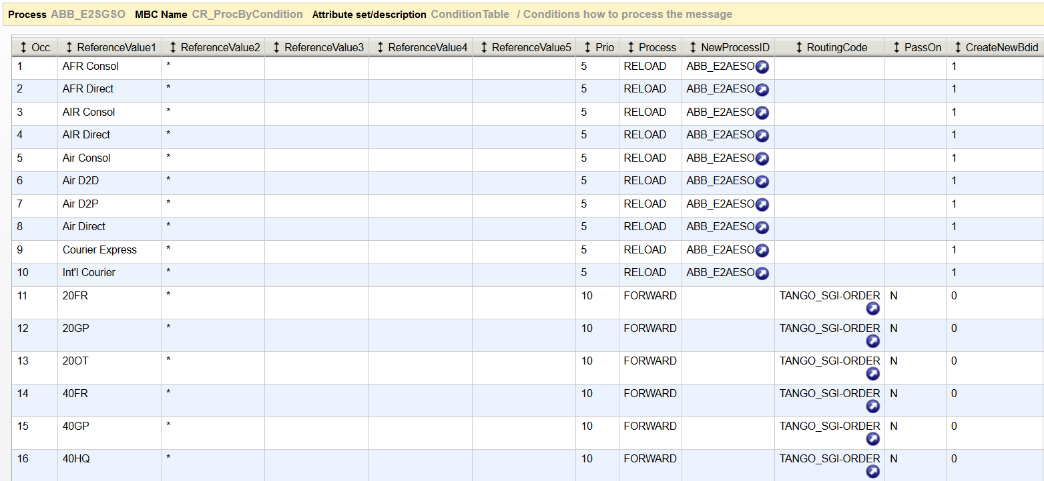
CR_ProcByCondition

Slide 31
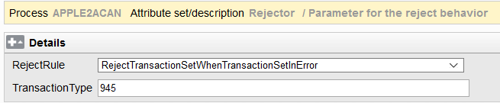
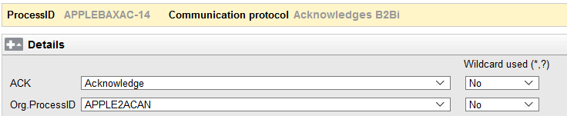
InboundX12
With InboundX12 ansi files are splitted into messages. The header information is removed.

Slide 32
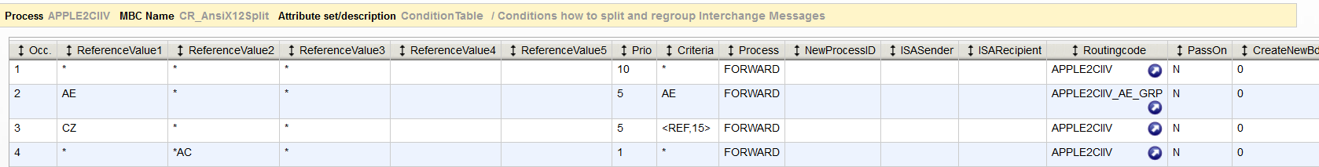
CR_AnsiX12Split

Slide 33
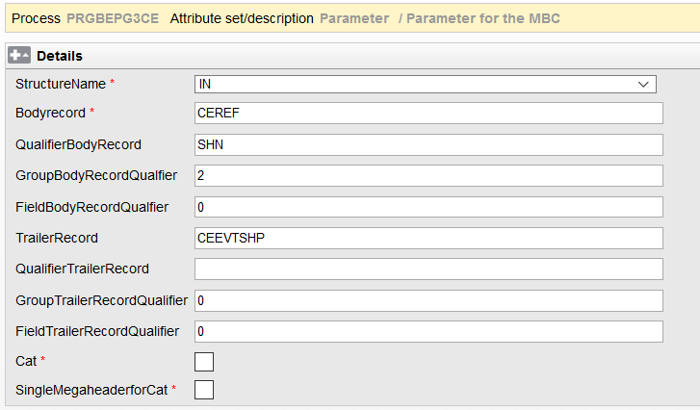
CR_MsgSplit
Multiple outgoing file

Slide 34
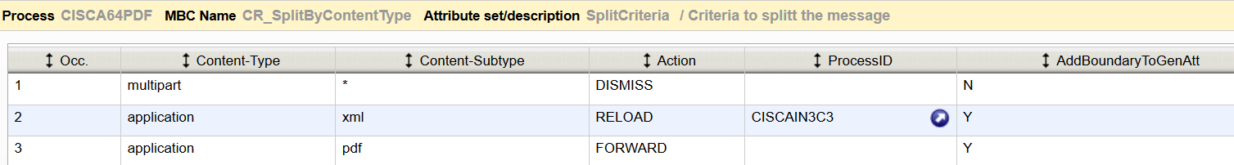
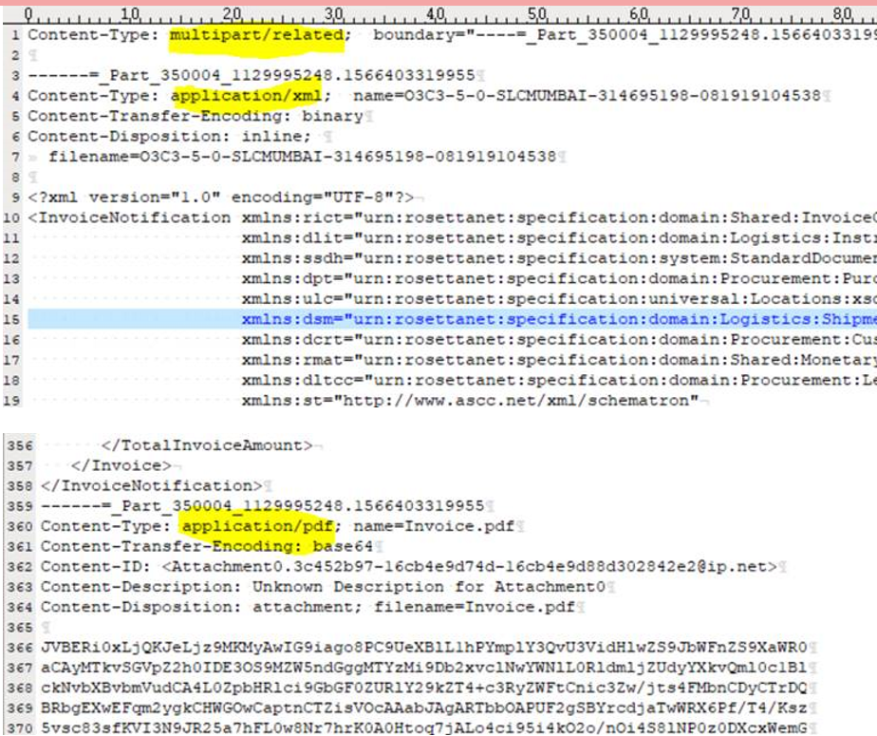
CR_SplitByContentType

Slide 35
EnvelopeX12
ConditionTable
FunctionalGroup
General
Interchange
RefIndex
StartCriteria
TransactionSet

Slide 36
Thank you

